Slide 1
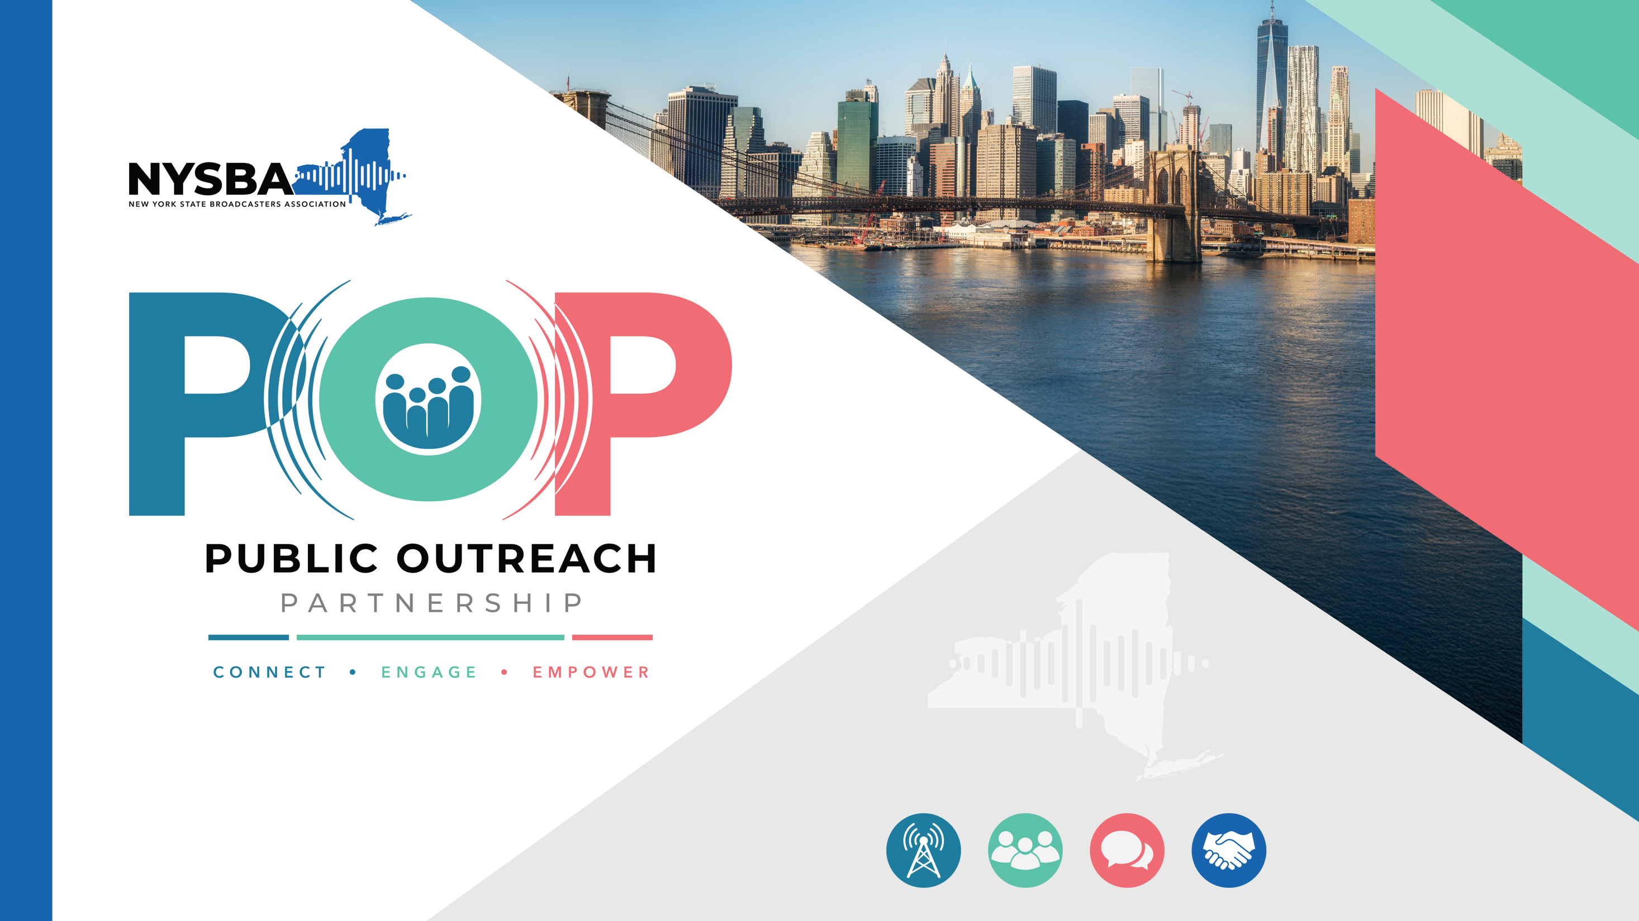

Slide 2
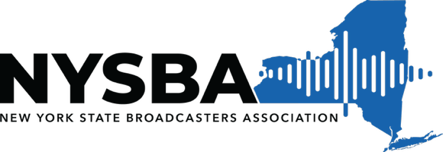


A PSA alternative that guarantees reach across all of New York State.

Slide 3
The Problem with PSAs
PSAs won’t properly get your message to your audience
PSAs Don’t Reach Your Audience
Broadcast during off-hours and overnight slots
Often pre-empted
Little incentive for stations to prioritize

Slide 4
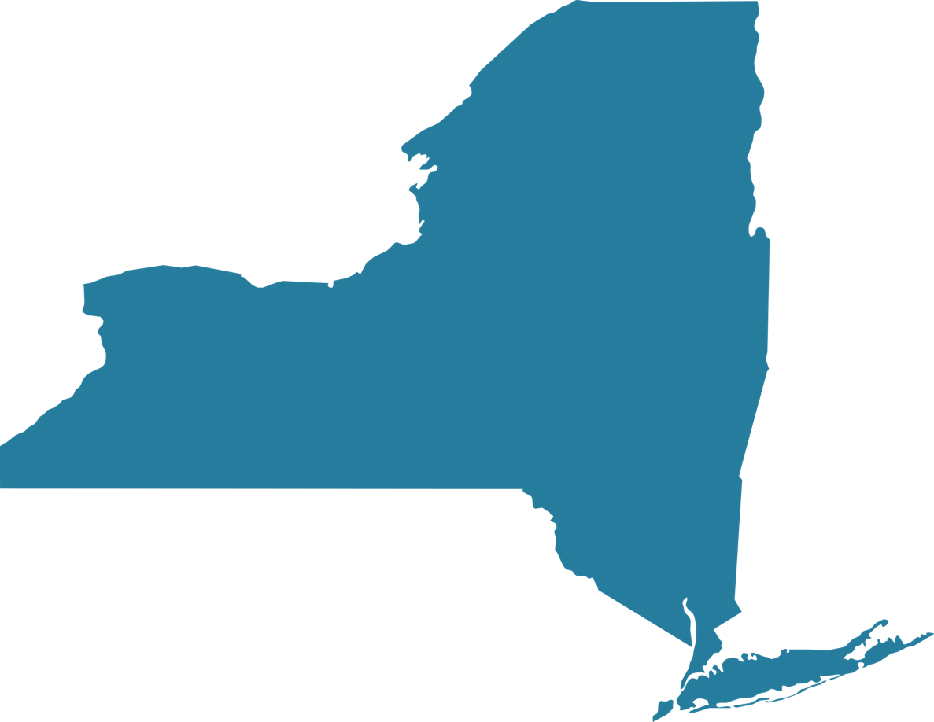
Solution: POP by NYSBA
High Reach, High Efficiency Broadcast Media Solutions
Reach 100% of New York State homes through via channels carried on cable, satellite and over-the-air reception.
56
TV Stations
100%
160
Radio Stations
32
State Markets

Slide 5
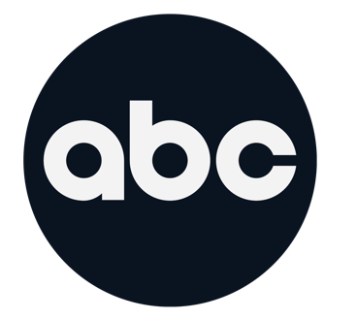



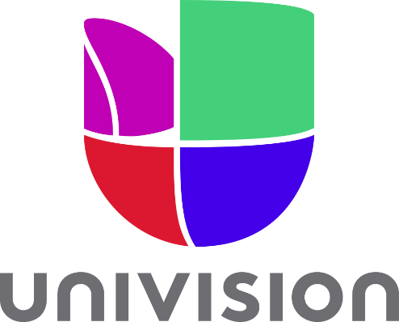



POP by NYSBA
High Reach, High Efficiency Broadcast Media Solutions
Every Major Affiliate
With reach among every major affiliate channel in New York State we can offer unparalleled reach throughout the entire state, increasing your visibility, and minimizing your budget.

Slide 6
POP by NYSBA
High Reach, High Efficiency Broadcast Media Solutions
KEY NYSBA Features
19 Million+
New York State Residents
Stations participate on a voluntary basis
Existing Distribution agreement with NY Office of General Services (OGS)
No need for RFP for each campaign
Buy 100% Guaranteed Impressions
Reach on TV, Radio, and Digital Channels
No charge for radio overnight spots
Aggregates high value advertising time

Slide 7


POP by NYSBA
High Reach, High Efficiency Broadcast Media Solutions
Features:
PSA’s
POP by NYSBA
Allow for true audience targeting
Guarantee high value & popular spots on radio & TV
100% coverage in all NYS homes
Offers at-cost digital extensions
Provide at-cost TV & Radio spot production

Slide 8
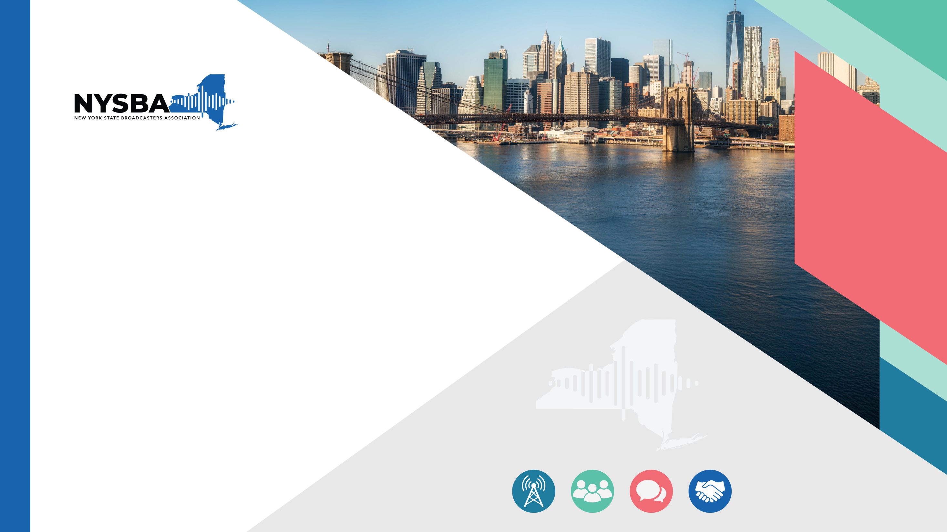
NYSBA Media Solutions
How the New York State Broadcasters Association can guarantee proper reach and delivery

Slide 9
TV Reach
Larger television reach than any other broadcast provider
New York State TV Markets | Stations
NY City | 12
Albany | 6
Binghamton | 6
Buffalo | 5
Plattsburgh/Burlington | 5
Rochester | 5
Syracuse | 5
Elmira/Corning | 4
Utica | 4
Watertown | 4
TOTAL | 56
56 NYS TV Stations
6x the number of TV stations as the largest broadcast operator
Multiple stations in every market participate on a voluntary basis
Reach on OTA, cable, and satellite
Hours spent watching TV has increased 10% since 2019 to 5.5 hours per day

Slide 10
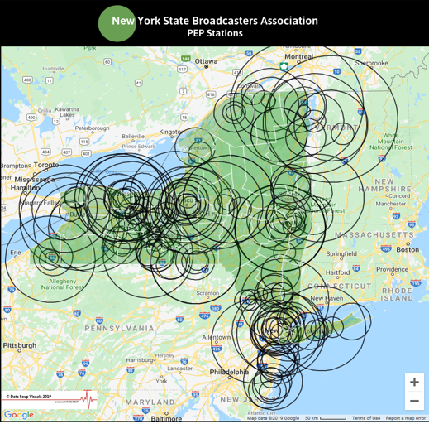
Radio Reach
High Reach, High Efficiency Broadcast Media Solutions
160 NYS Radio Stations
Reach includes FM/AM, social media, and smart speakers
Can be tailored to reach specific demographics
Multiple stations in most markets
Buy Guaranteed Impressions for A18+, measured by Nielsen
Markets | Stations | Markets | Stations | Markets | Stations
New York City | 38 | Port Jervis | 4 | Ithaca | 2
Albany | 18 | Utica | 4 | Malone | 2
Rochester | 12 | Binghamton | 4 | New Rochelle | 2
Syracuse | 11 | Newburgh | 3 | Watertown | 1
Geneva | 11 | Glens Falls | 3 | Waverly/Sayre | 1
Buffalo | 7 | Long Island | 3 | Beacon | 1
Jamestown | 6 | Plattsburgh | 2 | Bridgeport | 1
Warsaw | 5 | Potsdam | 2 | Canandaigua | 1
Cohoes | 5 | Batavia | 2 | Hornell | 1
Elmira | 5 | Dansville | 2 | Lake Placid | 1
*Participate on a voluntary basis

Slide 11

Digital Solutions
High Reach, High Efficiency Broadcast Media Solutions
Add Digital To Your Campaign
Adding digital media allows you to hyper-target your specific audience across all digital devices including mobile, desktop, tablets, and OTT/CTV.
NYSBA offers at-cost digital advertising solutions as an added value benefit for all customers. Let our team develop a custom digital advertising based around your specific needs.
Native Ads
Display
Pre-Roll
OTT/CTV
Geo-Fencing
Social Media
Email Marketing

Slide 12
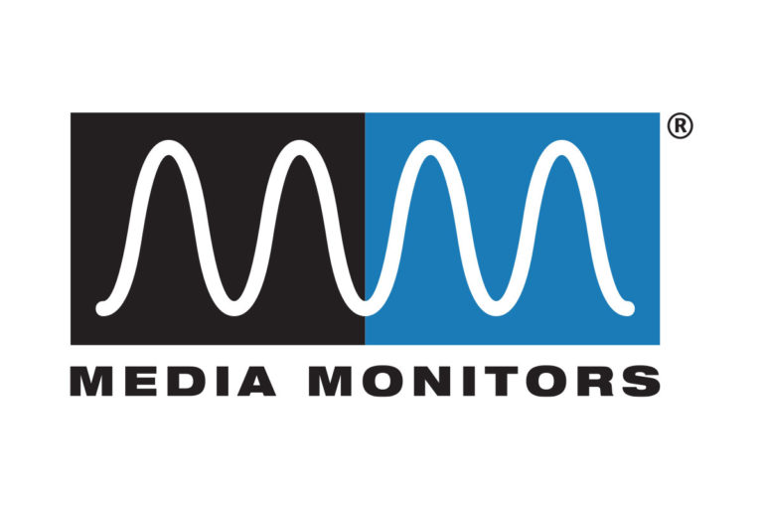

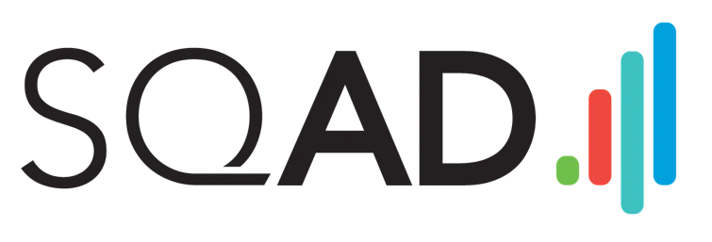
Proof of Performance
High Reach, High Efficiency Broadcast Media Solutions
Every Buy Includes:
Nielson “Sigma” data service
Media Monitors - radio
Station Affidavits from small markets
Value analysis by SQAD
Monthly reports showing total value delivered vs. investment
Reporting includes spots, tv impressions, and reported value

Slide 13

Working Together

Slide 14
Working with POP
All media proposals are custom built for your specific needs
Guaranteed Impressions
Move Fast
Cost Effective
Only pay for 100% guaranteed impressions on TV and Radio
Reach 100% of New York State residents (19M+ individuals)
All buys measured and confirmed via SQAD & Nielsen
NYSBA has existing distribution agreement with NY Office of General Services (OGS)
NY Agencies distributing messages through OGS do NOT need separate RFPs for each new campaign
No charge for Radio Overnight spots, EVER
No agency placement fees charged by NYSBA
Most competitive rates in the industry

Slide 15


Working with POP
Additional Value Adds from NYSBA
College Promotions
Direct Connection
NYSBA can share your message with state college radio stations for additional reach
NYSBA provides a direct connection to television and radio stations across the state

Slide 16
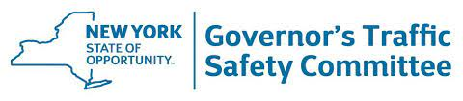



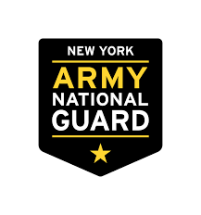
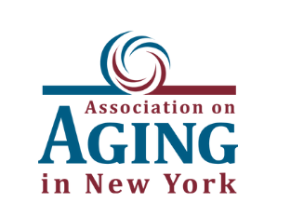

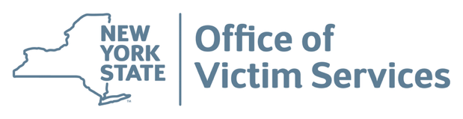

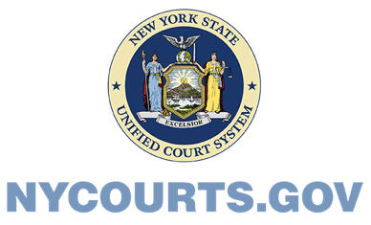
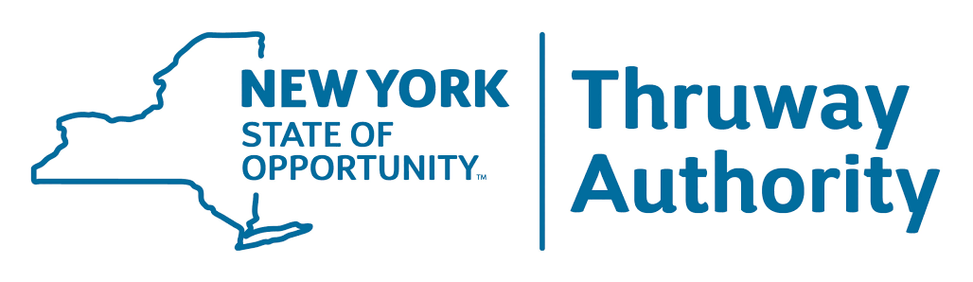
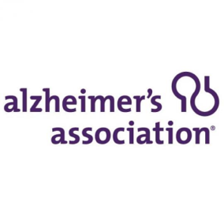
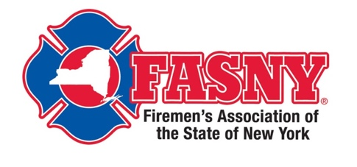

Working with POP
We have experience working with NY State Agencies and non-profits
Heidi Raphael
President NYSBA
hraphael@nybroadcasters.org
(518) 456-8888

Slide 17
Thank You!

